Slide 1
To-Do list Web Application
Liam Harrold

Slide 2
Introduction
To-Do list project
Agile project management
Jira – Epics, User Stories
SOLID Principles

Slide 3
Concept
Tasks, Users
Many tasks to one user relationship
Users store personal information and their tasks
Tasks store task category and description

Slide 4
Sprint Plan
User stories – Epics, estimations, priority
Focussed on each story at a time
Kanban board

Slide 5
Consultant Journey
Java – Previously used
Spring – New technology
HTML, CSS, JavaScript – Previous experience
H2 console (MySQL) – Experience with MySQL not H2
Maven- Previous experience
Junit – Previous experience
Mockito – New technology
Selenium – New technology

Slide 6
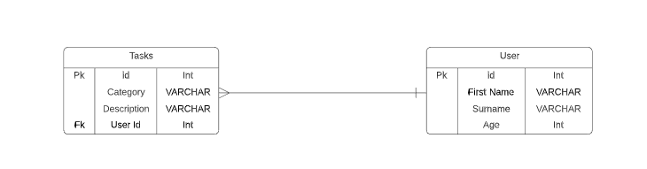
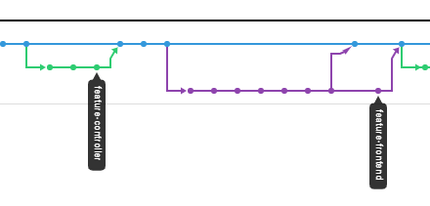
CI pipeline
Source code: Java/Spring – Spring tool suite, HTML/CSS/JavaScript – Visual Basic Studio
Version Control System: Git/GitHub
Project Tracking: Jira
Build Tool: Maven
Automated Testing: Junit, Mockito
User acceptance testing: Selenium
Master
Dev

Slide 7
Testing
Src/main/Java : 60% test coverage
Service and Controller tests 90-100% coverage
Next step: Exception testing
Selenium testing – Page navigation, Entity creation

Slide 8
Sprint review
Completed all user stories for minimum viable product
Focussed on accuracy of project
No time for extension tasks

Slide 9
Sprint Retrospective
What went well?
Followed user stories in logical way
Requirements met
Flexible timings
Future Improvements
Usage of feature-branch model

Slide 10
Conclusion
Thoughts
Happy with how I worked
Consolidation of skills being taught
Overcame issues well – Nested JSON
Further steps
Add a user/login system
Use GCP for database

Slide 11
Thanks for Listening
Demonstration
ANY Questions?

